Slide 1
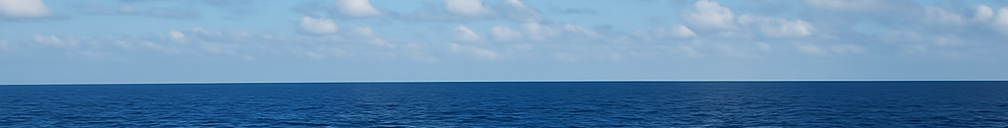


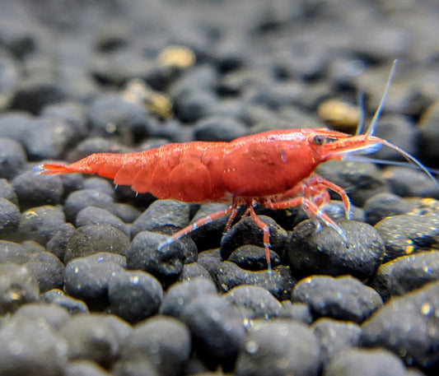
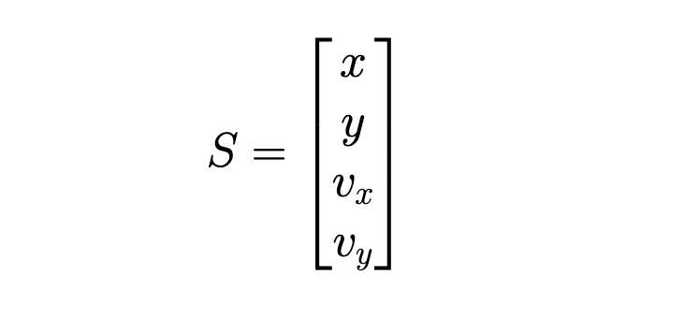
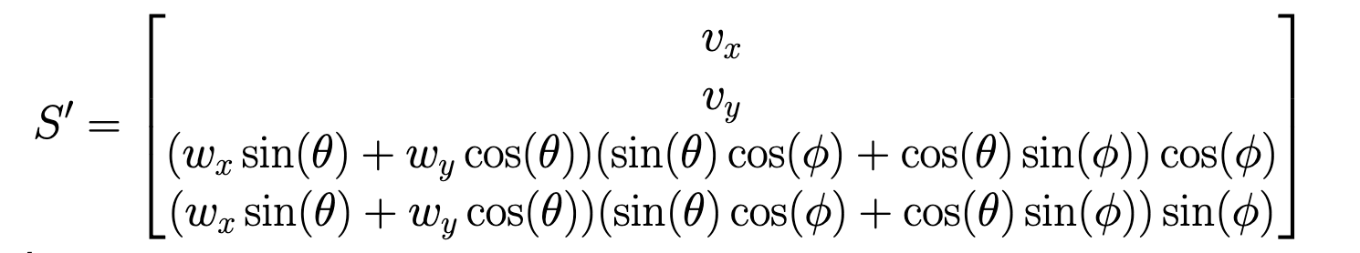
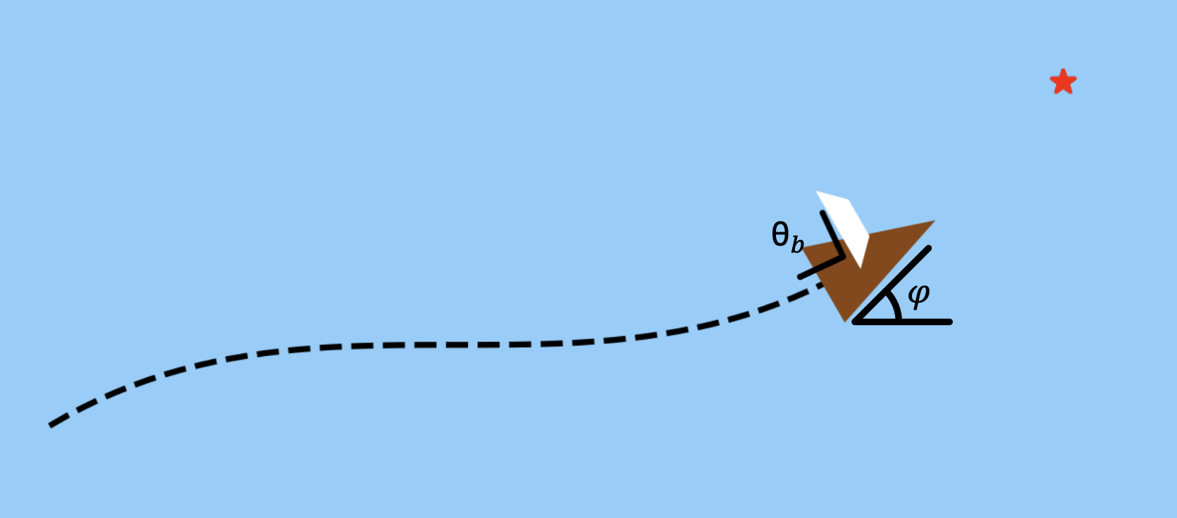
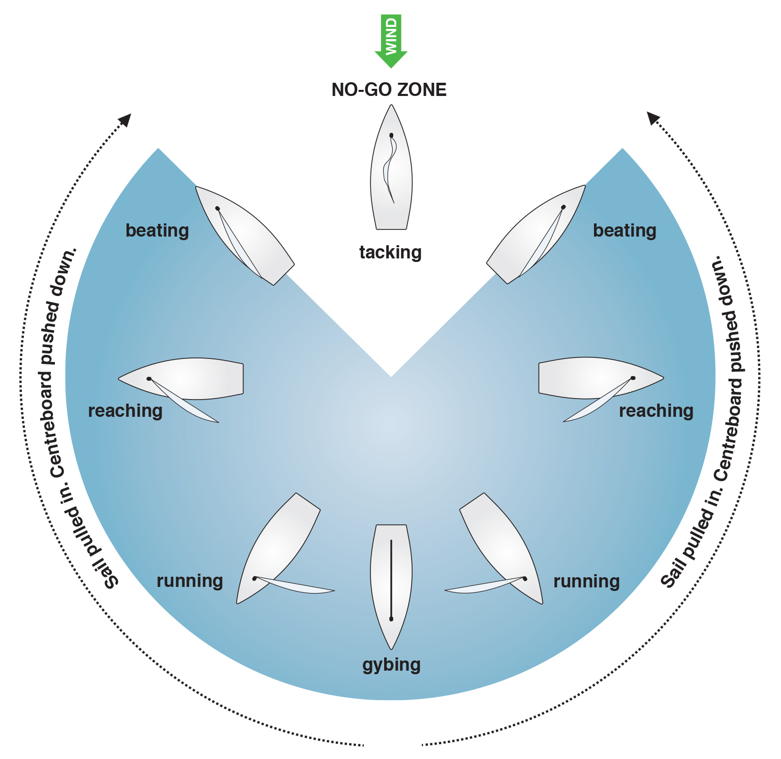
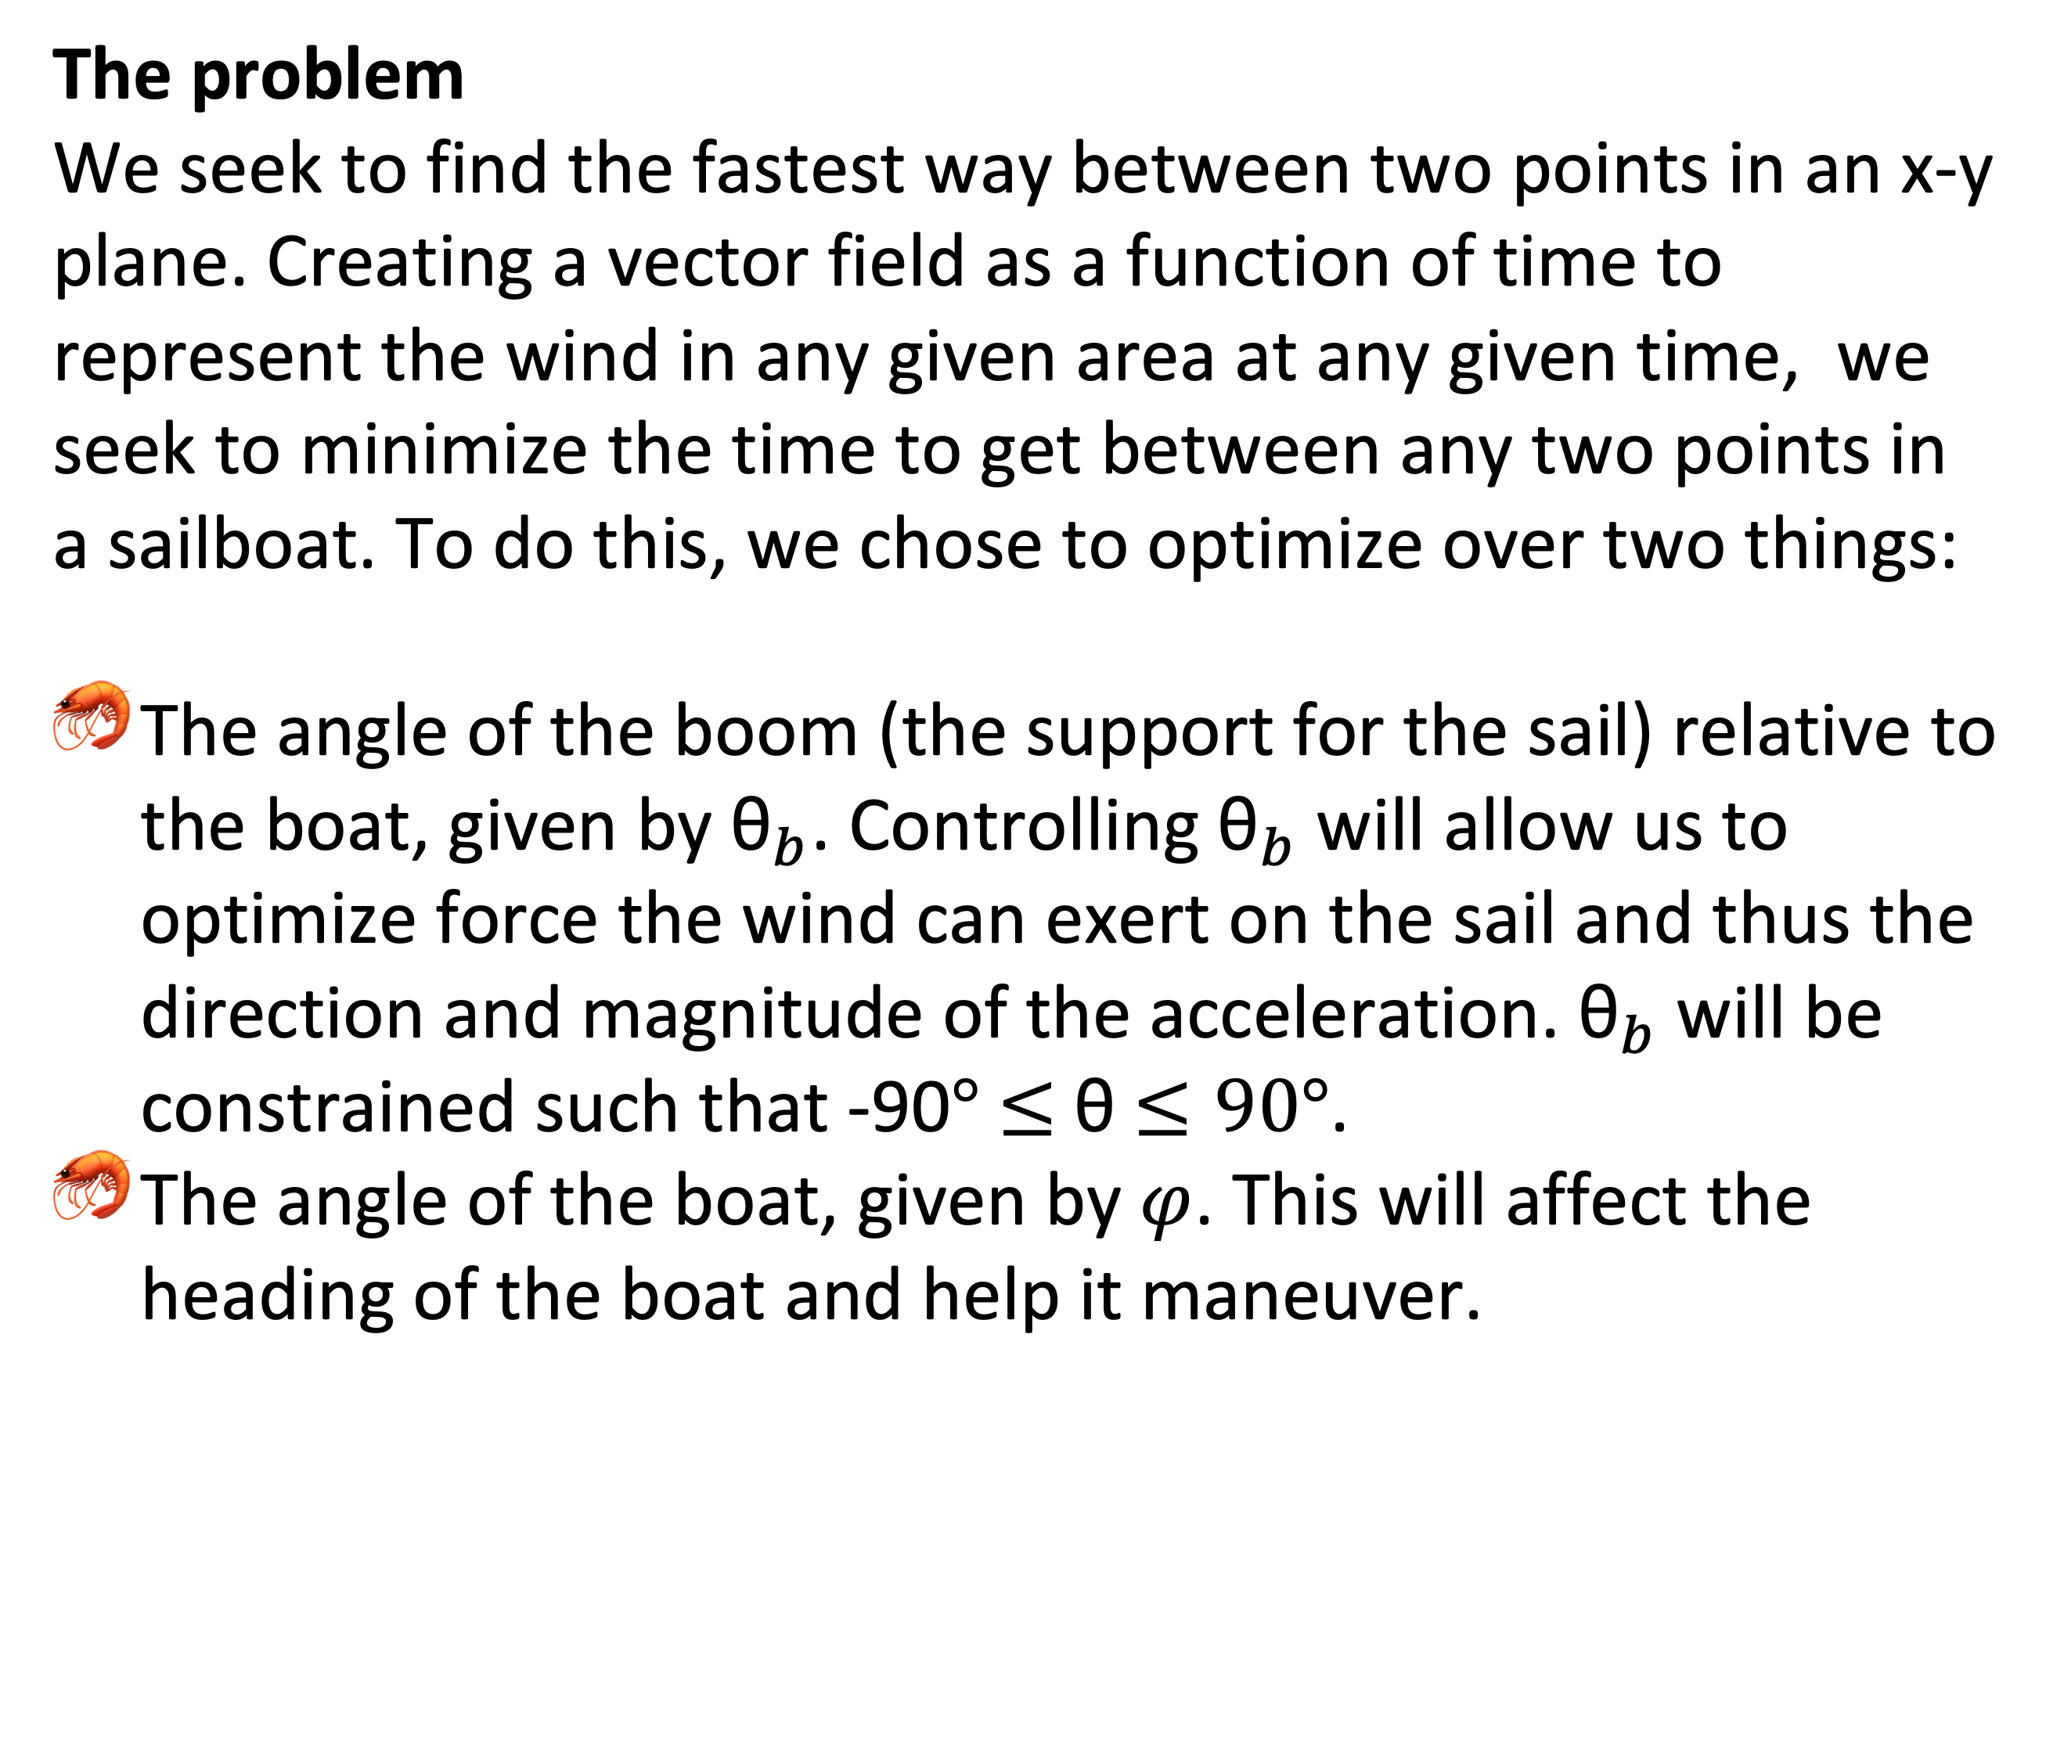
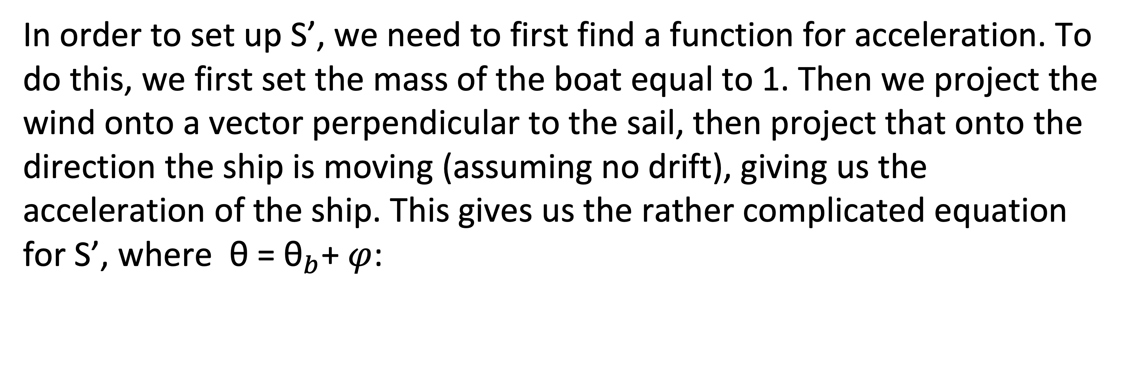

Uncharted Waters
“We must sail – sometimes with the wind and sometimes against it – but we must sail” (Oliver Wendell Holmes)
Dallin Anderson, Joseph Du Toit, Abraham Harris, Nephi Suyama, Ryan Wood
Overview Sailing is an art and tool that has been used by mankind for millennia. While experienced sailors likely know the most efficient and fastest way to sail from point A to point B given certain wind conditions, we take on the problem of using optimal control to find the best way to get from point A to point B.
Equations
Results
To get our state equation, we have:
In order to set up S’, we need to first find a function for acceleration. To do this, we first set the mass of the boat equal to 1. Then we project the wind onto a vector perpendicular to the sail, then project that onto the direction the ship is moving (assuming no drift), giving us the acceleration of the ship. This gives us the rather complicated equation for S’, where θ = ${\text{θ}}_{b}$+ $φ$:
The problem
We seek to find the fastest way between two points in an x-y plane. Creating a vector field as a function of time to represent the wind in any given area at any given time, we seek to minimize the time to get between any two points in a sailboat. To do this, we chose to optimize over two things:
The angle of the boom (the support for the sail) relative to the boat, given by ${\text{θ}}_{b}$. Controlling ${\text{θ}}_{b}$ will allow us to optimize force the wind can exert on the sail and thus the direction and magnitude of the acceleration. ${\text{θ}}_{b}$ will be constrained such that -90$°$ $≤$ θ $≤90°$.
The angle of the boat, given by $φ$. This will affect the heading of the boat and help it maneuver.
Conclusions and next steps
Figure 1:
Illustration of what ${\text{θ}}_{b}$ and $φ$ represent
The approach
First we solve the simple case of sailing in one direction with the wind at our backs, finding the simple optimal control of ${\text{θ}}_{b}$ = $\frac{1}{2}\tan^{−1}{(\frac{{−w}_{y}}{w_{x}})}$ where $w_{x}$ and $w_{y}$ are the x and y components of the wind vector, respectively
With a reasonable answer for this case, we then expanded to the 2D scenario we now have, optimizing not just over θ but $φ$ as well.
Figure 2:
[1] The no go zone. The white wedge shows the direction the boat cannot go while tacking into the wind, one of several problems we take into account in our optimal control.
References
[1] https://fernhurstbooks.com/knowledge_centre/94/points_of_sailing
Right-Angle Icons - Free SVG & PNG Right-Angle Images - Noun Project
Angle - Free education icons
For angle icons

Slide 2
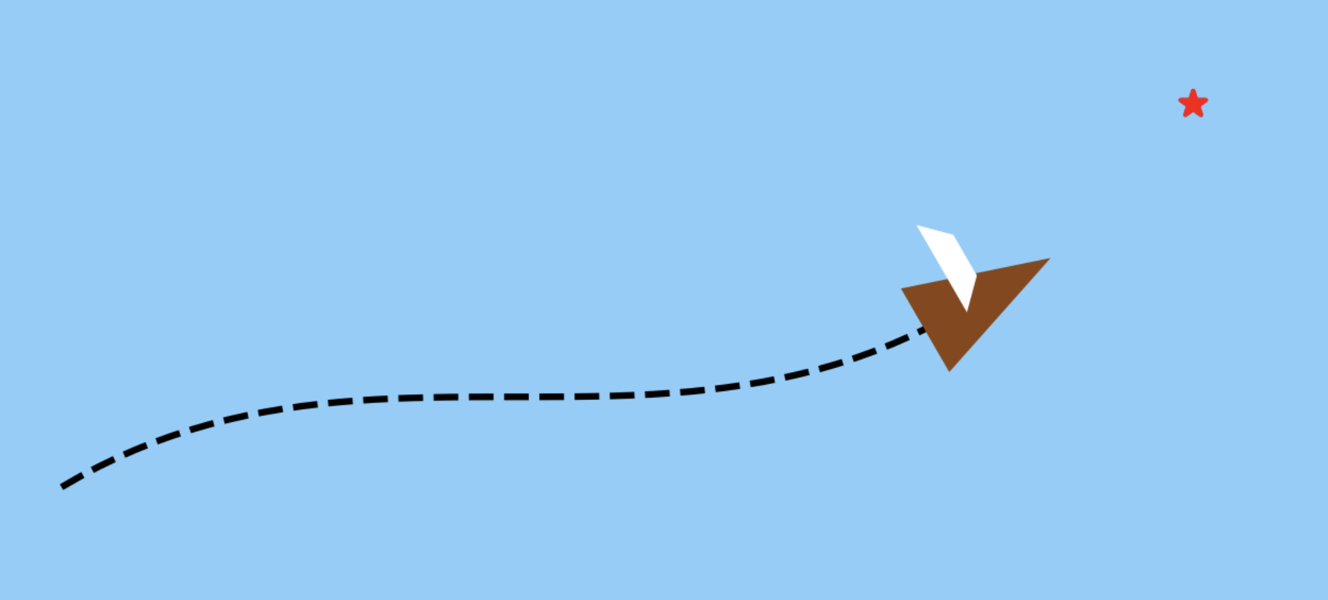
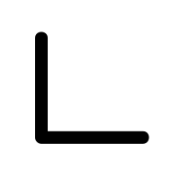
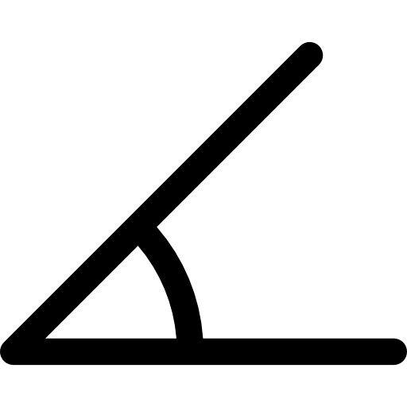
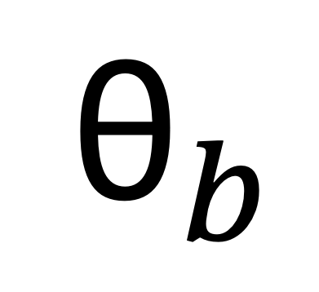
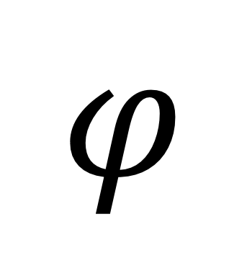
$${\text{θ}}_{b}$$
$$φ$$

